Slide 1
Automated Cartography Solutions (ACS)
Providing A New Automated Mapping Solution

Slide 2
Our Members
Jake Streett – App Developer
Scott Efird – Server and Database Administrator
Sam Smith – Test Pilot and Website Developer

Slide 3
The Problem
Google Maps provides users with satellite images of the world. That is great, but the images are update infrequently (1-3 years*)
//PICTURE OF GOOGLE MAPS UNABLE TO DISPLAY DATA

Slide 4
Potential Uses
Who needs more update maps?
Open face mines
Construction companies
Farmers (cattle counts)
…ect?

Slide 5
The Solution
ACS! Automated Cartography Solutions.
What is required?
A Drone and a Phone! That is it.
//PICTURE OF MAP OVERLAYED WITH OUR RENDER
Our solution is a cheap and easy to implement and can be done by hobbies to corporations.

Slide 6
How It Works
The user opens the ACS App, selects a region they want to map, connect the phone to the drone and that is it! The phone will take pictures as the drone flies and upload them to our server.

Slide 7
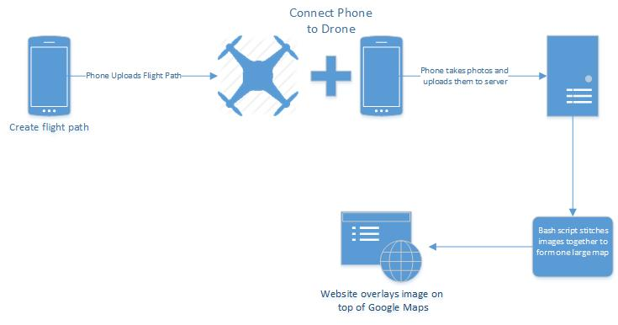
Project Overview

Slide 8
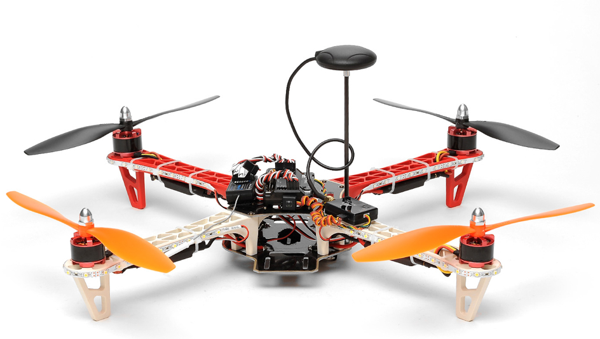
Drone
//WE DON’T NEED ALL THIS CRAP NO ONE GIVES A SHIT. DO A BRIEF SUMMARY OF WHAT IT IS
Specification: Dimensions: 47x47cm (18.5inches x 18.5 inches) Weight: 750g Height: 12cm Four 10 inch Propellers Battery: 3s 2200mAh 2.4G 6CH Radio Motor: Four 2212 Outrunner Brushless 920KV Motors ESC: ESC: 4pcs 40A Brushless (Hobbywing) Speed Controllers Load: 1300G Flight Control Board: MX led GPS installed.
05P-FlightControl-Mega-MX Mega 2.52 is a complete open source autopilot system featuring the best selling technology. This version is ready to use, with no assembly required. It allows the user to turn any fixed wing, rotary wing or multi-rotor vehicle (even boats and car) into a fully autonomous vehicle capable of performing programmed GPS missions with waypoints (GPS module required - sold separately). Features: • Arduino Compatible • pre-soldered and tested • 3-axis gyro, accelerometer, magnetometer and high-performance barometer • Built in 4 MP Dataflash chip for automatic data logging • Honeywell HMC5883L-TR Digital compass • InvenSense 6 DoF Accelerometer/Gyro MPU-6000 • Measurement Specialties MS5611-01BA03 Barometric pressure sensor. • Atmel ATMEGA2560 and ATMEGA32U-2 (processing and USB function).
05P-GPS-38400-APM This is an updated GPS module that can used with ardupilot mega v2. This GPS module uses the latest technology to give the best possible position information, allowing for better performance with your Ardupilot or other Multirotor control platform. You may require to configure this module for use with your flight controller (MultiWii Copter I2C GPS board requires 115200 baud). You will require a USB to FTDI adaptor board to do this. Please note that this module ships with default settings and a baud rate of 38400. Features: • Standalone GPS receiver • U-blox NEO-6M GPS module • Under 1 second time-to-first-fix for hot and aided starts • SuperSense ® Indoor GPS: -162 dBm tracking sensitivity • Anti-jamming technology • Support SBAS (WAAS, EGNOS, MSAS, GAGAN) • U-blox 6 50 channel positioning engine with over 2 million effective correlators • Timepulse • 5Hz position update rate • Operating temperature range: -40 TO 85°C • UART TTL socket • EEprom to store settings • Rechargeable battery for Backup • Build in 18X18mm GPS antenna • RoHS compliant
Specification: Dimensions: 47x47cm (18.5inches x 18.5 inches) Weight: 750g Height: 12cm Four 10 inch Propellers Battery: 3s 2200mAh 2.4G 6CH Radio Motor: Four 2212 Outrunner Brushless 920KV Motors ESC: ESC: 4pcs 40A Brushless (Hobbywing) Speed Controllers Load: 1300G Flight Control Board: MX led GPS installed.
05P-FlightControl-Mega-MX Mega 2.52 is a complete open source autopilot system featuring the best selling technology. This version is ready to use, with no assembly required. It allows the user to turn any fixed wing, rotary wing or multi-rotor vehicle (even boats and car) into a fully autonomous vehicle capable of performing programmed GPS missions with waypoints (GPS module required - sold separately). Features: • Arduino Compatible • pre-soldered and tested • 3-axis gyro, accelerometer, magnetometer and high-performance barometer • Built in 4 MP Dataflash chip for automatic data logging • Honeywell HMC5883L-TR Digital compass • InvenSense 6 DoF Accelerometer/Gyro MPU-6000 • Measurement Specialties MS5611-01BA03 Barometric pressure sensor. • Atmel ATMEGA2560 and ATMEGA32U-2 (processing and USB function).
05P-GPS-38400-APM This is an updated GPS module that can used with ardupilot mega v2. This GPS module uses the latest technology to give the best possible position information, allowing for better performance with your Ardupilot or other Multirotor control platform. You may require to configure this module for use with your flight controller (MultiWii Copter I2C GPS board requires 115200 baud). You will require a USB to FTDI adaptor board to do this. Please note that this module ships with default settings and a baud rate of 38400. Features: • Standalone GPS receiver • U-blox NEO-6M GPS module • Under 1 second time-to-first-fix for hot and aided starts • SuperSense ® Indoor GPS: -162 dBm tracking sensitivity • Anti-jamming technology • Support SBAS (WAAS, EGNOS, MSAS, GAGAN) • U-blox 6 50 channel positioning engine with over 2 million effective correlators • Timepulse • 5Hz position update rate • Operating temperature range: -40 TO 85°C • UART TTL socket • EEprom to store settings • Rechargeable battery for Backup • Build in 18X18mm GPS antenna • RoHS compliant

Slide 9
Cost
AeroSky P 12 Quadcopter “ready to fly” = 449.95
*OtterBox Defender Series Case = 45.95
//Cost of phone?
Total: 495.90
*The OtterBox case and clip is used for attaching the phone to the drone.

Slide 10
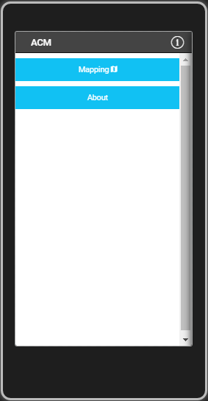
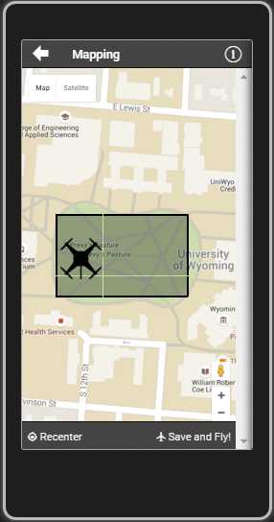
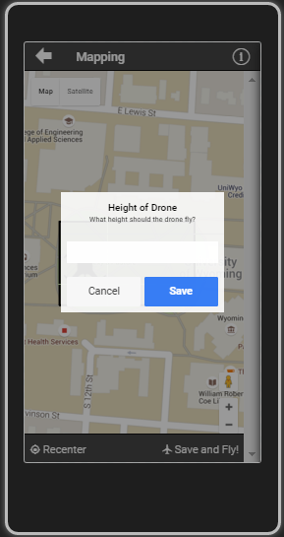

ACS App

Slide 11
App Overview
This app is a cross platform app which is built using the following library's:
AngularJS (1.4)
Apache Cordova (3.5.1)
Ionic(1.2.4)
jQuery
The app will create and upload a flight path to the Drone.
It also will take and upload photos to the server.

Slide 12
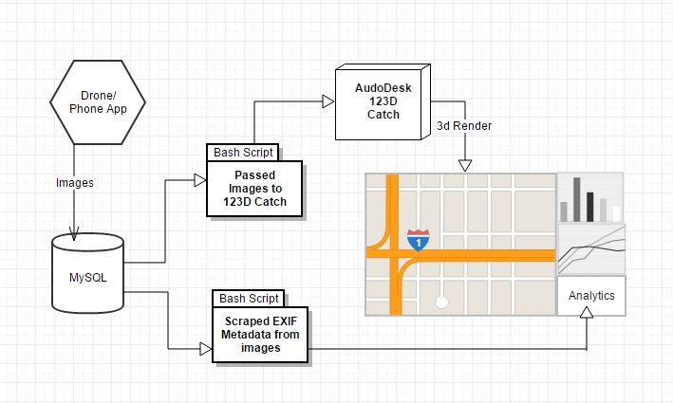
Server Infrastructure Overview

Slide 13
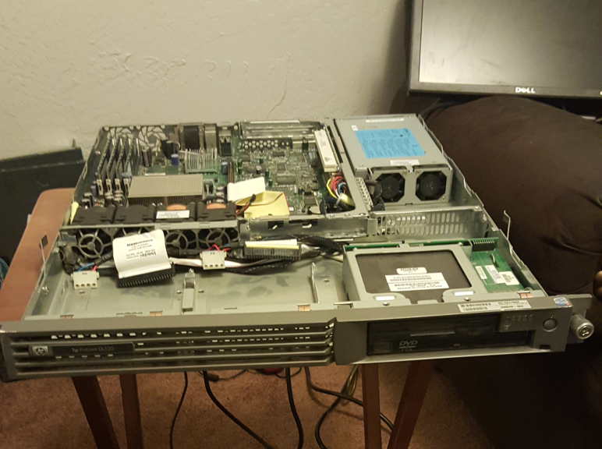
Primary Database Server
Running Xubuntu 15.10
Uses MySQL to hold the images
Uses several bash scripts
to process the images
HP ProLiant DL320

Slide 14
Server Side Code
Formats images to a uniform size
Scrapes image metadata
Enforces image naming conventions
Creates a master content list
Passes images to Autodesk 123D Catch

Slide 15
Autodesk 123D Catch
Creates 3D objects using a large set of images
Originally we created a system using ImageMagick and Javascript
Now we record video with the phone and scrape images from it using VLC Player

Slide 16
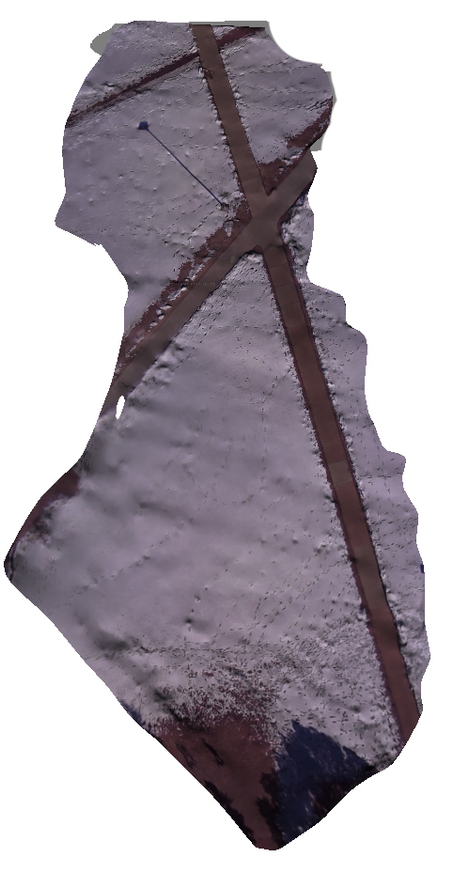
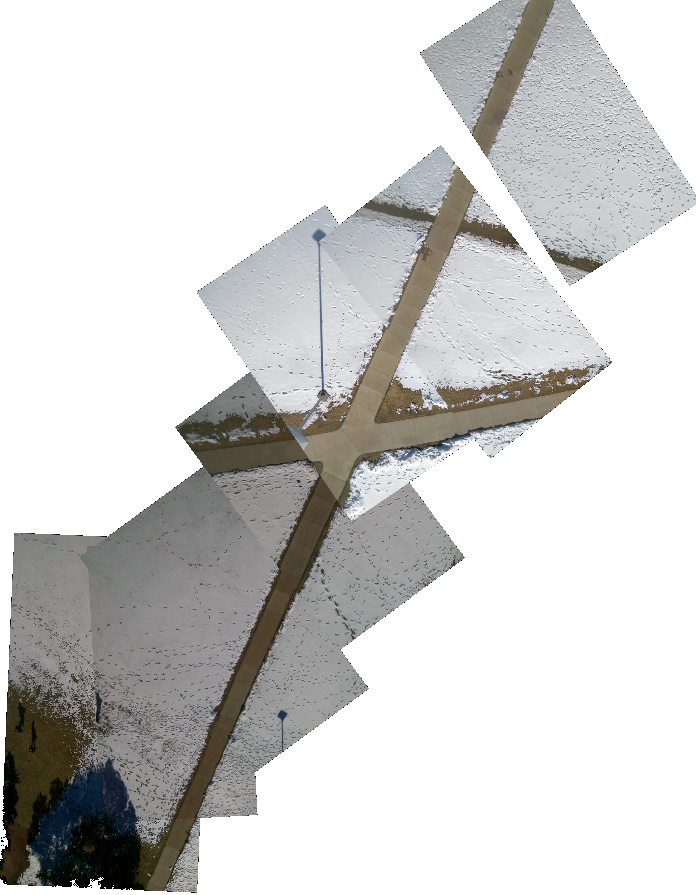

Slide 17
//I NEED A TITLE

Slide 18
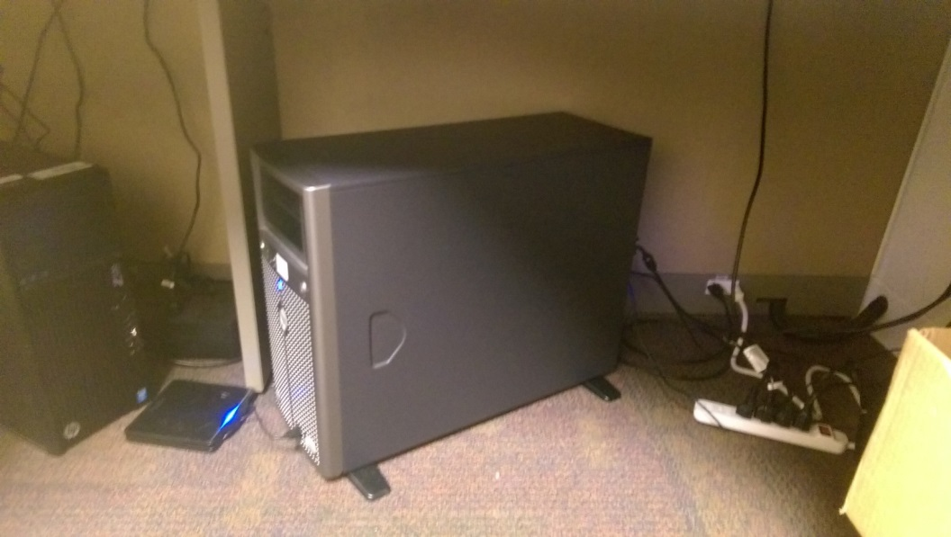
Website
Using Bootstrap, Ajax and Javascript
Acts as a hub for all our public facing systems
In the future, directly tie into the app

Slide 19
Analytical Information
Using data both from the drone’s flight path and from the phone we can run high level analytics.
Average speed, estimated distance between images, GPS information
Could be compiled into an automated report to emailed after each flight

Slide 20
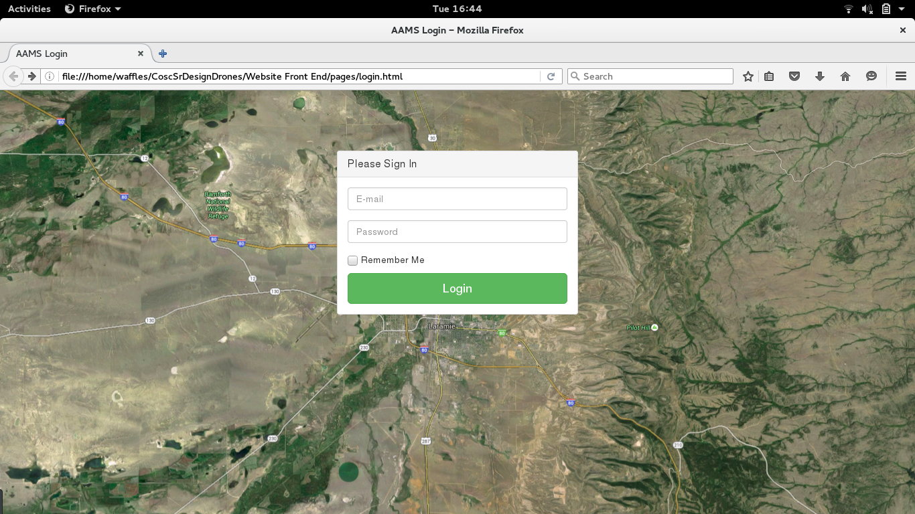

Slide 21
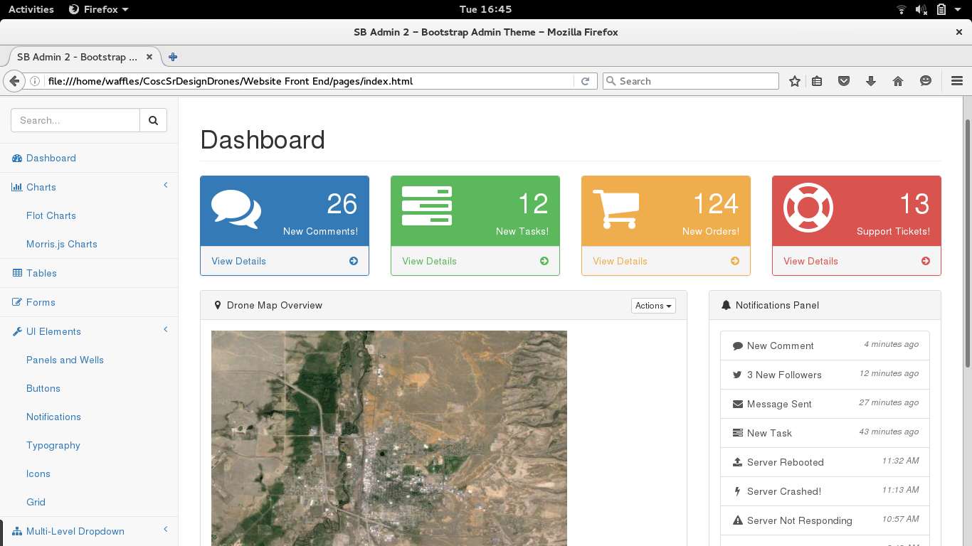

Slide 22
Future Improvements
Low cost hardware upgrades
Move our hardware to the cloud
Automatically generated reports
Camera stabilizing mount
Real time video rendering

Slide 23
Q&A?

